Slide 1

VoltWatch: Secure AI Monitoring of Smart Energy Grids
Group Project Proposal
Group Members:
Samuel Howard
Cameron Johnson
April Crockett
Blaine Swieder

Slide 2



Motivation
Modern electric power grids face the ongoing challenge of:
balancing electricity supply & demand
while minimizing cost
protecting consumer privacy
ensuring security of the system, and
maintaining reliability.
As energy systems become more distributed with consumers increasingly acting as both users and producers of power, there is a growing need for intelligent, secure, and flexible coordination mechanisms.

Slide 3
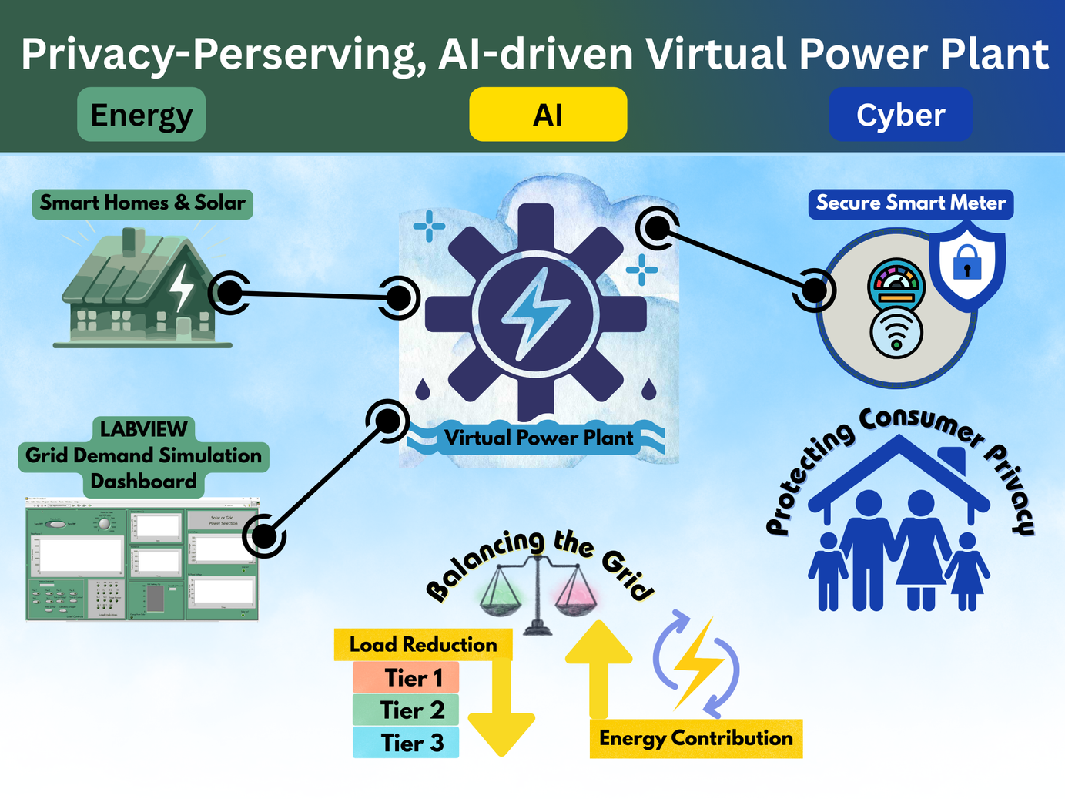
Vision
We will combine
data analysis (using time-based energy data),
signal processing,
AI-driven deision-making, and
cybersecurity principles
to demonstrate how small, coordinated actions across many consumers can support grid stability without requiring intrusive control or detailed personal data.

Slide 4




Interdisciplinary Integration
Energy
AI
Cybersecurity
We aim to demonstrate energy application by using measured time-series energy data representative of grid behavior.
Implement AI-driven decision logic to apply small-scale load adjustments based on system conditions .
Integrate cybersecurity through privacy-preserving communication.
4

Slide 5



Possible Data Sources
41 .csv files collected from 20 residential electricity households within a community in Ireland as part of StoreNet project.
Aggregate and per-appliance measurements sampled at 15 Hz from 22 houses in Korea.
Archive of 2,075,259 measurements of active energy consumed every minute of one house in Sceauz, France fo 47 months.

Slide 6
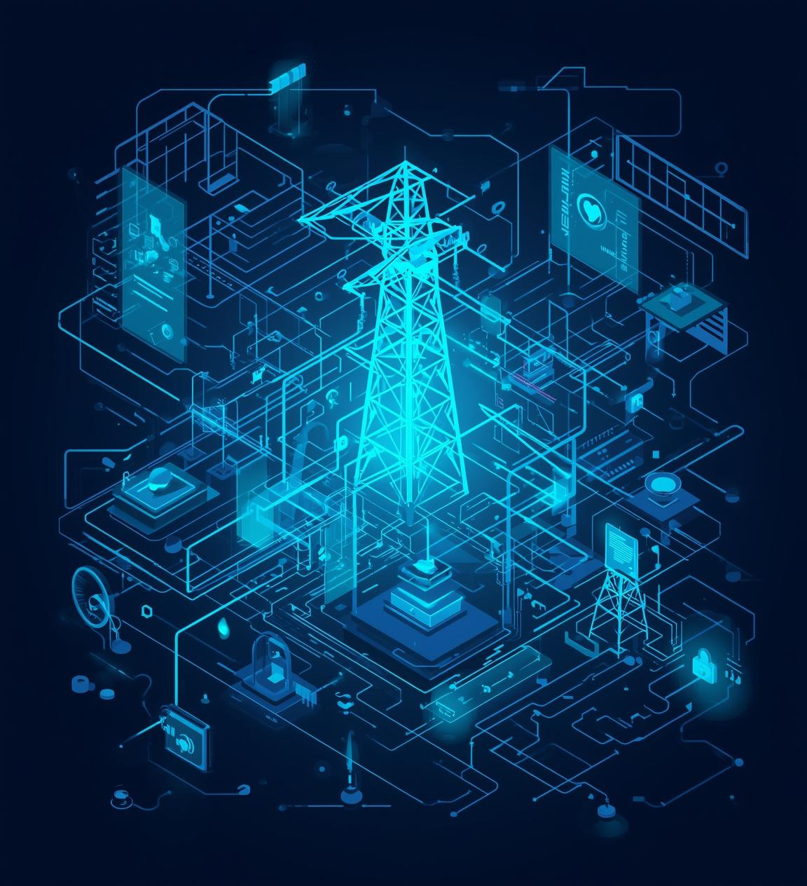
Documented Challenges
Grid Challenges
Increased complexity due to distributed energy resources challenges real-time supply-demand balance..
Cyber Challenges
Smart grid montoring introduces privacy & cyberseurity risks.
Our Response
We will address these challenges by demonstrating an AI-assisted virtual power plant that operates on aggregated time-seris data rither than individual household profiles. We will also use privacy-perserving validation mechanisms.

Slide 7

Approach and Methodology
System Architecture
Modular Design - Agile Development
Data Ingestion
Signal Processing
AI Decision Engine
Cyber Validation Layer
Visualization Dahboarrd

Slide 8
Approach and Methodology
Team Roles & Responsibilities
Samuel Howard
Cameron Johnson
April Crockett
Blaine Swieder
Lead AI & Cyber development, including decision logic design, demand analysis, threshold-based action modeling, and cyber security modeling
Lead Energy data procurement and preprocessing, data analysis, signal processing, and evaluation of system-level energy impacts.
Lead project docs, communication, and presentation materials, visualization design, creation of teaching materials for bootcamp. Serve a wildcard, aiding teammates where needed.
Lead System Integration and architectural coordination and ensuring interaction across AI, Cyber, and Energy components.

Slide 9
Tasks & Timeline
Task 1: Project Proposal & Timeline (timeline: 1 week)
Task 2: Data Acquisition and Preprocessing (timeline: 2 weeks)
Task 3: Energy Signal Processing Development (timeline: 1-3 weeks)
Task 4: AI Decision Logic Implementation (timeline: 3 weeks)
Task 5: Cybersecurity and Validation Modeling (timeline: 2 weeks)
Task 6: Mid Semester Milestone Presentation (timeline: 1 week)
Task 6: System Integration and Visualization (timeline: 2-3 weeks)
Task 7: Testing, Evaluation, and Refinement (timeline: 1 week)
Task 8: Preparing Bootcamp Presentation & Activities (timeline: 1 week)
Task 9: Final Presentation (1/2 week)

Slide 10
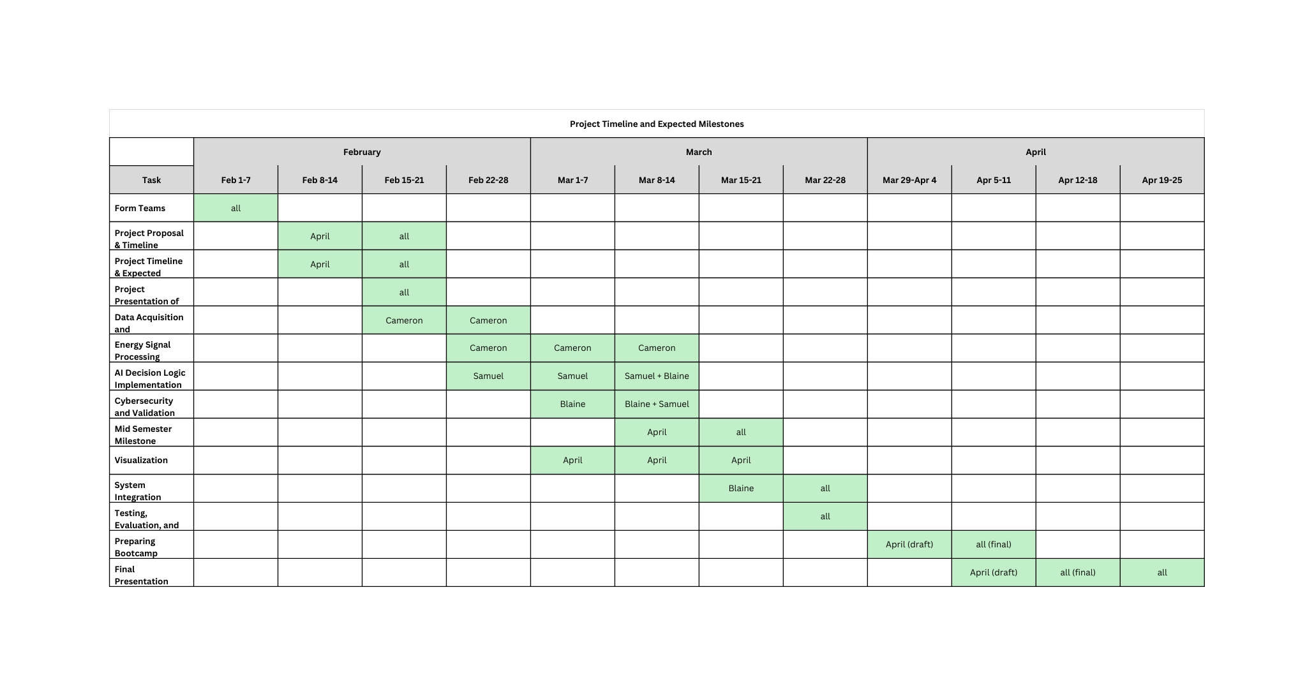
Tasks & Timeline

Slide 11
Intellectual Merit
Unique, Interdisciplinary Approach to Grid Stability
Grid Stability
Consumer-Side Privacy
AI Techniques
From an energy systems perspective, the project illustrates how small, distributed load adjustments can be coordinated to support grid stability using time-series demand data/
Contains anonymized validation and secure communication workflows illustrating how system-wide coordination can occur without exposing sensitive individual data, addressing a key challenge in smart grid deployments.
Demonstrates how lightweight AI techniques can be effectively applied to real-world infrastructure problems. By emphasizing rule-based and trend-aware decision logic rather than complex black-box models, the system prioritizes transparency, and appropriateness for safety-critical domains such as energy systems.
11

Slide 12

Broader Impacts
By demonstrating privacy-preserving approaches to energy coordination, the project promotes consumer confidence in smart grid technologies. The project will demonstrate that grid support mechanisms do not require invasive monitoring or control by utility providers.
The project also contributes to energy sustainability and resilience by highlighting how coordinated, low-impact actions across many users can reduce peak demand and improve grid stability.
From an educational and workforce development perspective, the project provides a clear, accessible example of how AI, cybersecurity, and energy concepts intersect in practice.
The project encourages responsible AI adoption by modeling systems that are aligned with societal values. By emphasizing privacy and minimal intrusion, the project supports broader efforts to develop trustworthy intelligent systems that serve the public good.

Slide 13
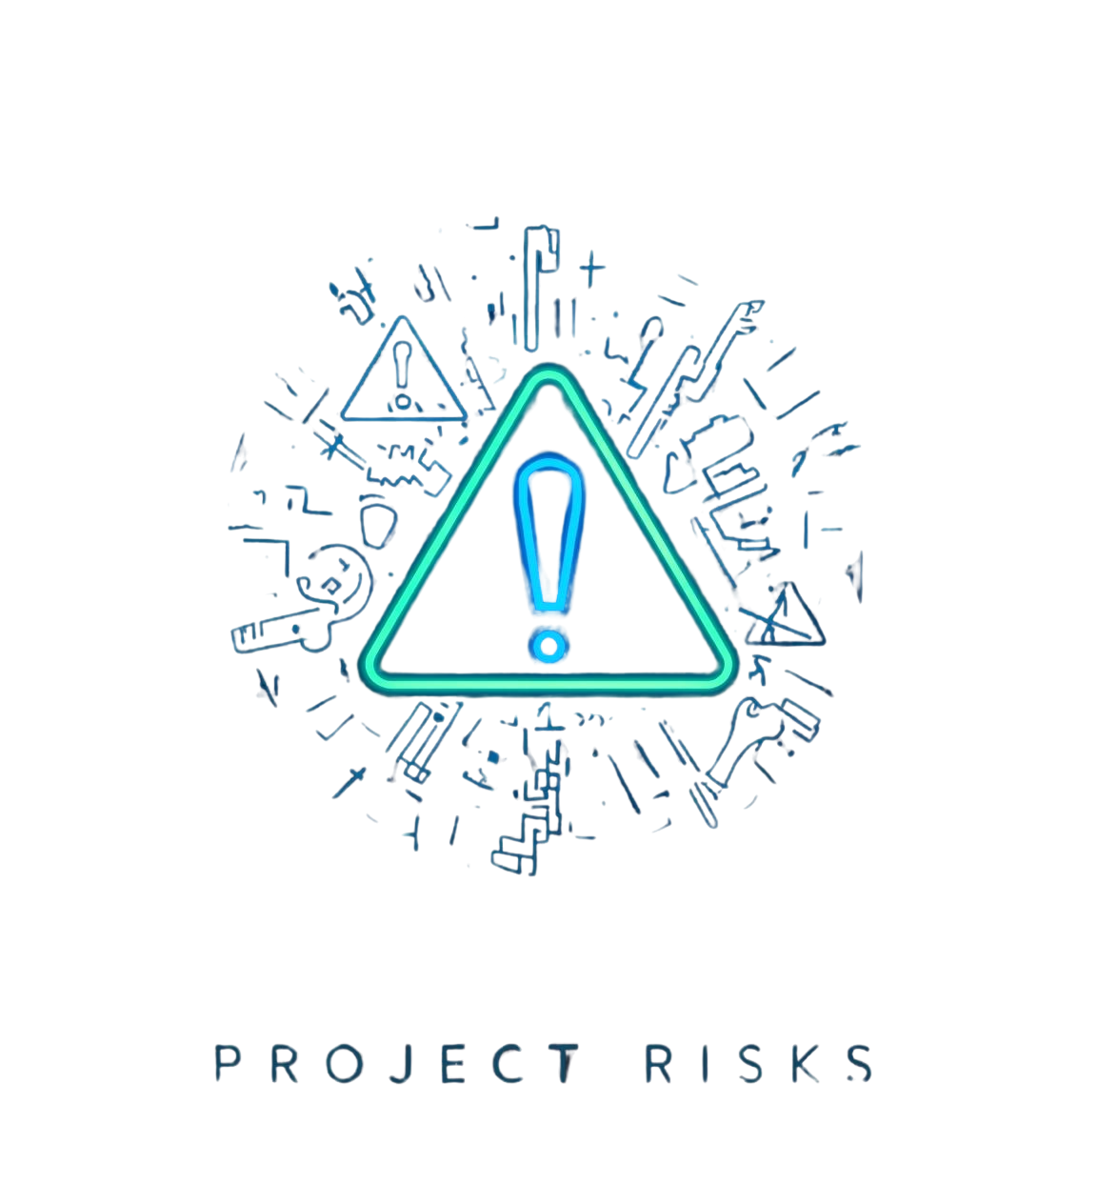
Addressing Project Risks and Alternatives
Publicly available energy datasets may be incomplete or too noisy to adequately represent grid behavior. If real-world datasets prove insufficient, the project will supplement or replace them with synthetically generated time-series data that reflects typical demand patterns.
The AI component may be either too simplistic to demonstrate meaningful system behavior or too complex to remain interpretable and aligned with project goals. The project will adopt an iterative AI design approach, starting with a consumption predictor and some form of ruleset and then progressively adding trend-based or predictive elements only if they improve clarity and usefulness.
Developing a live-updating visualization may require more time or technical effort than anticipated. If real-time dashboards are not feasible, the project will use static or step-based visualizations.
Limited project duration or overlapping responsibilities may affect progress across tasks. Tasks will be prioritized to ensure core project objectives are met first, including energy demonstration and AI decision logic. Optional or enhancement features will be deferred if necessary, and responsibilities will be rebalanced within the team to maintain progress.

Slide 14

Questions?
Thank you for your attention!

